Slide 1


Road Safety Objectives Report
1 April 2026 – 30 June 2026

Slide 2
Update on Key Actions
1 April 2026 – 30 June 2026

Slide 3
Road Policing Investment Programme (RPIP) update
Road policing activity | 2025/26 Target | 2025/26 Delivery | Difference to 2025/26 target | Quarterly target | April-June 2026 delivery | Difference to quarterly target
Breath tests | 3,300,000 | 4,071,630 | + 771,630 | 825,000 | 792,484 | - 32,516
Breath tests at high-risk times | 2,145,000 | 2,814,515 | + 669,515 | 536,250 | 557,429 | + 21,179
Officer issued speed offences | 430,000 | 514,786 | + 84,786 | 107,500 | 115,624 | + 8,124
Officer issued speed offences under 11km/h over the speed limit | 75,250 | 111,633 | + 36,383 | 18,813 | 25,875 | + 7,062
Officer issued speed offence notices on open roads | 301,000 | 320,705 | + 19,705 | 75,250 | 71,852 | - 3,398
Restraint offences | 60,000 | 43,473 | - 16,527 | 15,000 | 8,903 | - 6,097
Cell phone offences | 40,000 | 53,765 | + 13,765 | 10,000 | 11,911 | + 1,911
RPIP outcomes framework: www.beehive.govt.nz/sites/default/files/2024-08/Road%20Policing%20Investment%20Programme%202024-27.pdf

Slide 4
Road Safety Objectives – Output summary
1. Safer roads: lift the quality of our road infrastructure
Roads of National Significance and Roads of Regional Significance | NZTA: Pre‑implementation and route protection activities continue on several Roads of National Significance projects, including preparing for consent and Notice of Requirement lodgements through the Fast-track Approvals Act. Construction on the Hawke’s Bay Expressway and the Omanawa Bridge replacement are now well underway. Cambridge to Piarere is preparing to go to tender. Warkworth to Te Hana is on track for financial close as scheduled.
Increase road maintenance and renewal, with complementary investment in safety treatments | NZTA: Overall, delivery across FY24/25 and FY25/26 is expected to meet both maintenance/renewal and the rehabilitation targets from NZTA’s Statement of Performance Expectations. Resurfacing and rehabilitation programmes across the country have been delayed by weather events in January and February, particularly in the North Island. 90-95% of the planned surfacing programme has been delivered. Complementary safety improvements (ie, upgrades to road markings, signage and roadside barriers) are integrated into maintenance and renewal programmes through planning and prioritisation.
Develop and deliver innovative, cost-effective safety infrastructure measures in high-crash areas | NZTA: Of the 55 safety projects carried forward from the previous National Land Transport Plan (NLTP), 31 are complete and 13 are underway. Of the 11 safety projects over $2 million, 2 projects are now complete, 7 remain underway, and 2 are yet to start. Of the over 200 small safety projects to be delivered, 78 are now complete, and 60 are underway. The speed management programme is expected to be largely delivered within the NLTP period.
Motorcycle safety-specific treatments to reduce deaths and serious injuries | NZTA & ACC: NZTA is continuing to support ACC to develop the next programme of motorcycle safety works. A measurement framework is being established to assess Stage 1 performance. Potential future intervention opportunities are also being assessed on high-risk intersections, with programme recommendations expected by the end of Q1 FY27.

Slide 5
Road Safety Objectives – Output summary
2. Safer drivers: ensure road users are alert, unimpaired and comply with road rules
Increase road policing and enforcement | Police: Delivery for the last quarter of the 2025-26 annual Road Policing Investment Programme (RPIP) is below target for breath tests, open road speed notices and restraints. Police exceeded the 2025-26 year-end targets across activity measures, other than restraint offences.
Implement roadside oral fluid testing (OFT) | Police: District training has been completed. Police are on track for the national rollout of 50,000 OFT per annum from 1 July 2026.
Deliver education initiatives and public information to support Police enforcement and encourage behavioural change focusing on high-risk behaviours | NZTA: Campaigns this quarter targeted speed, motorcycles, drink-driving, drug-driving, distractions (in partnership with ACC), seatbelts (in collaboration with Northland and Canterbury NPC rugby teams), safe winter travel and general enforcement. In May, the: Better Together initiative ran in Northland, Central, Tasman/West Coast and Southern Police districts. campaign to inform drivers of the new roadside drug testing regime began in May. NZTA hosted a cross-agency road safety stand at the 10-13 June National Fieldays.
Identify opportunities to improve the Graduated Driver Licensing System (GDLS), taking into account road safety outcomes | The Ministry: The Governor-General signed the Amendment Rule on 7 April 2026. NZTA: NZTA is focussed on implementing the changes to the GDLS by January 2027.

Slide 6
Road Safety Objectives – Output summary
2. Safer drivers: ensure road users are alert, unimpaired and comply with road rules
Deliver and support others in their delivery of school-based road safety education | NZTA: Road Safety Week ran from 4-10 May. NZTA supported Brake by hosting the launch event, participating in school visits, and producing children’s road safety resources for schools, libraries and early childhood education centres. Visits to the Education Portal, a key road safety resource, increased by approximately 4% compared to the same period last year.
Continue optimising engagement in training and education programmes/development of new programmes | ACC & NZTA: The Drive programme had 80,229 new registrations for the financial year, exceeding the target of 60,000. Ride Forever recorded over 7,200 course completions, below the target of 8,500. NZTA delivered a workshop at the Driving Change Network conference in May to share Drive resources to support new drivers who face barriers to learning to drive (including those from isolated rural communities, migrants and refugees).
Review penalties for traffic offences and investigate improvements to the alcohol interlock programme | The Ministry: Work to review penalties for road safety offences and investigate improvements to the alcohol interlock programme continues.
Continue to explore initiatives to improve disproportionate outcomes for groups in New Zealand (ie, young people, rural residents, motorcyclists) | ACC & NZTA: Motorcycle risk maps were published on MegaMaps.

Slide 7
Road Safety Objectives – Output summary
3. Safer vehicles: improve the safety performance of our vehicle fleet
Safer vehicles work programme | NZTA: Continues to deliver the Last line of defence campaign, raising awareness of safety ratings and the RightCar website. New content focused on new parents changing cars to accommodate a growing family has been introduced. The Ministry and NZTA: Officials are preparing advice for the Associate Minister of Transport on new safety feature requirements for light and heavy vehicles entering the New Zealand fleet. The Ministry and NZTA: The Minister of Transport and Associate Minister of Transport announced that Cabinet has agreed to extend the inspection intervals and expand the scope of inspections for most light vehicles. Land Transport Rule: Vehicle Standards Compliance Amendment 2026 was signed in May 2026 and will take effect from 1 November 2026 across two stages.
Commence building of nationwide Commercial Vehicle Safety Centres | NZTA: The Commercial Vehicle Safety Centre (CVSC) in Bombay is now operational. CVSC Mackays Crossing is nearing completion, with the opening scheduled for July.

Slide 8
Road Safety Objectives – Output summary
4. Resetting speed: a balanced and targeted approach to speed limits
Implement speed limit reversals by 1 July 2025 and variable speed limits outside schools by 1 July 2026 | NZTA: All Road Controlling Authorities (RCAs) have implemented speed limit reversals as required by the Land Transport Rule: Setting of Speed Limits 2024. 59 local RCAs have implemented a variable speed limit on the road outside the school gate. NZTA continues to work with eight remaining local RCAs to facilitate compliance. Of the 200 variable speed limit electronic signs around schools on state highways, 24 are now complete and 171 are underway.
Investigate measures to increase the effectiveness of, and expand, the speed camera network | NZTA: NZTA has delivered 8 new average speed corridors between March and June 2026. The introduction of average speed cameras has resulted in 99% driver compliance across all average speed corridors. NZTA continues to work with NZ Police and local government to ensure risk-targeted deployment of mobile cameras.
5. Supporting action: enabling third-party funding
NZTA/ACC to identify options to increase the use of ACC injury prevention funding for road safety initiatives | ACC & NZTA: ACC and NZTA continue to develop proposals to increase ACC investment into infrastructure interventions to be assessed against the ACC investment criteria.

Slide 9
Update on Key Statistics
1 January 2026 – 31 March 2026

Slide 10
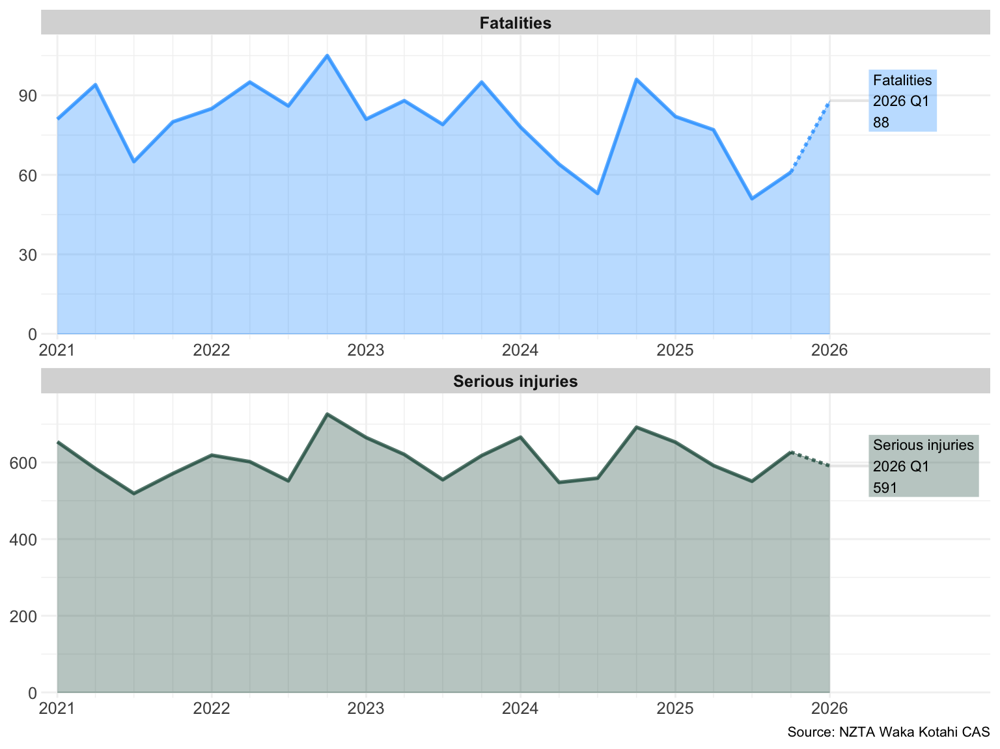
How are our outcomes tracking?
There were 88 fatalities and 591 reported serious injuries over the period of 1 January to 31 March 2026. This is above the average number of fatalities and serious injuries for the period since 2021.
Figure 1: Quarterly road crash injuries

Slide 11
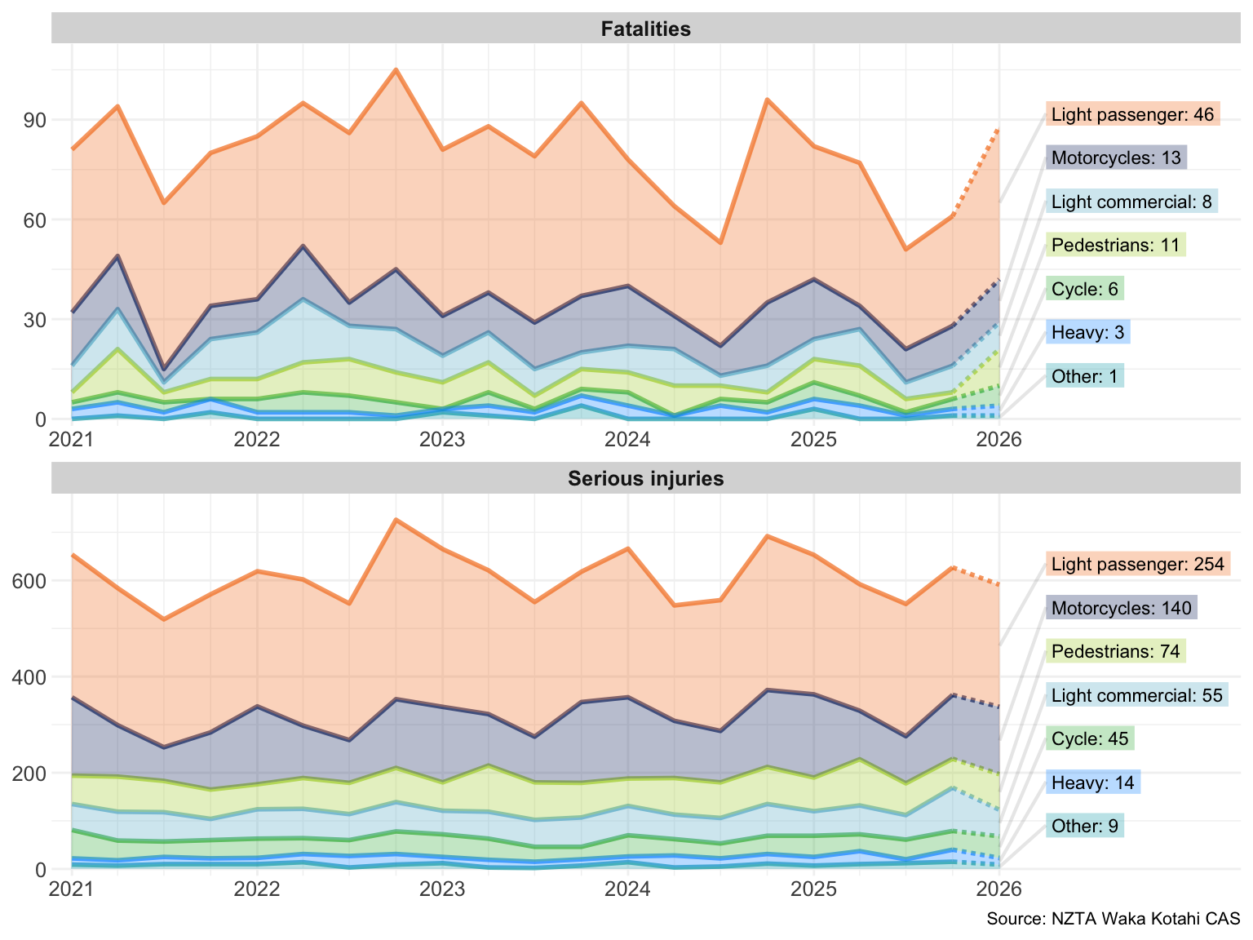
Road safety outcomes by mode
Figure 2: Quarterly road crash injuries by mode

Slide 12
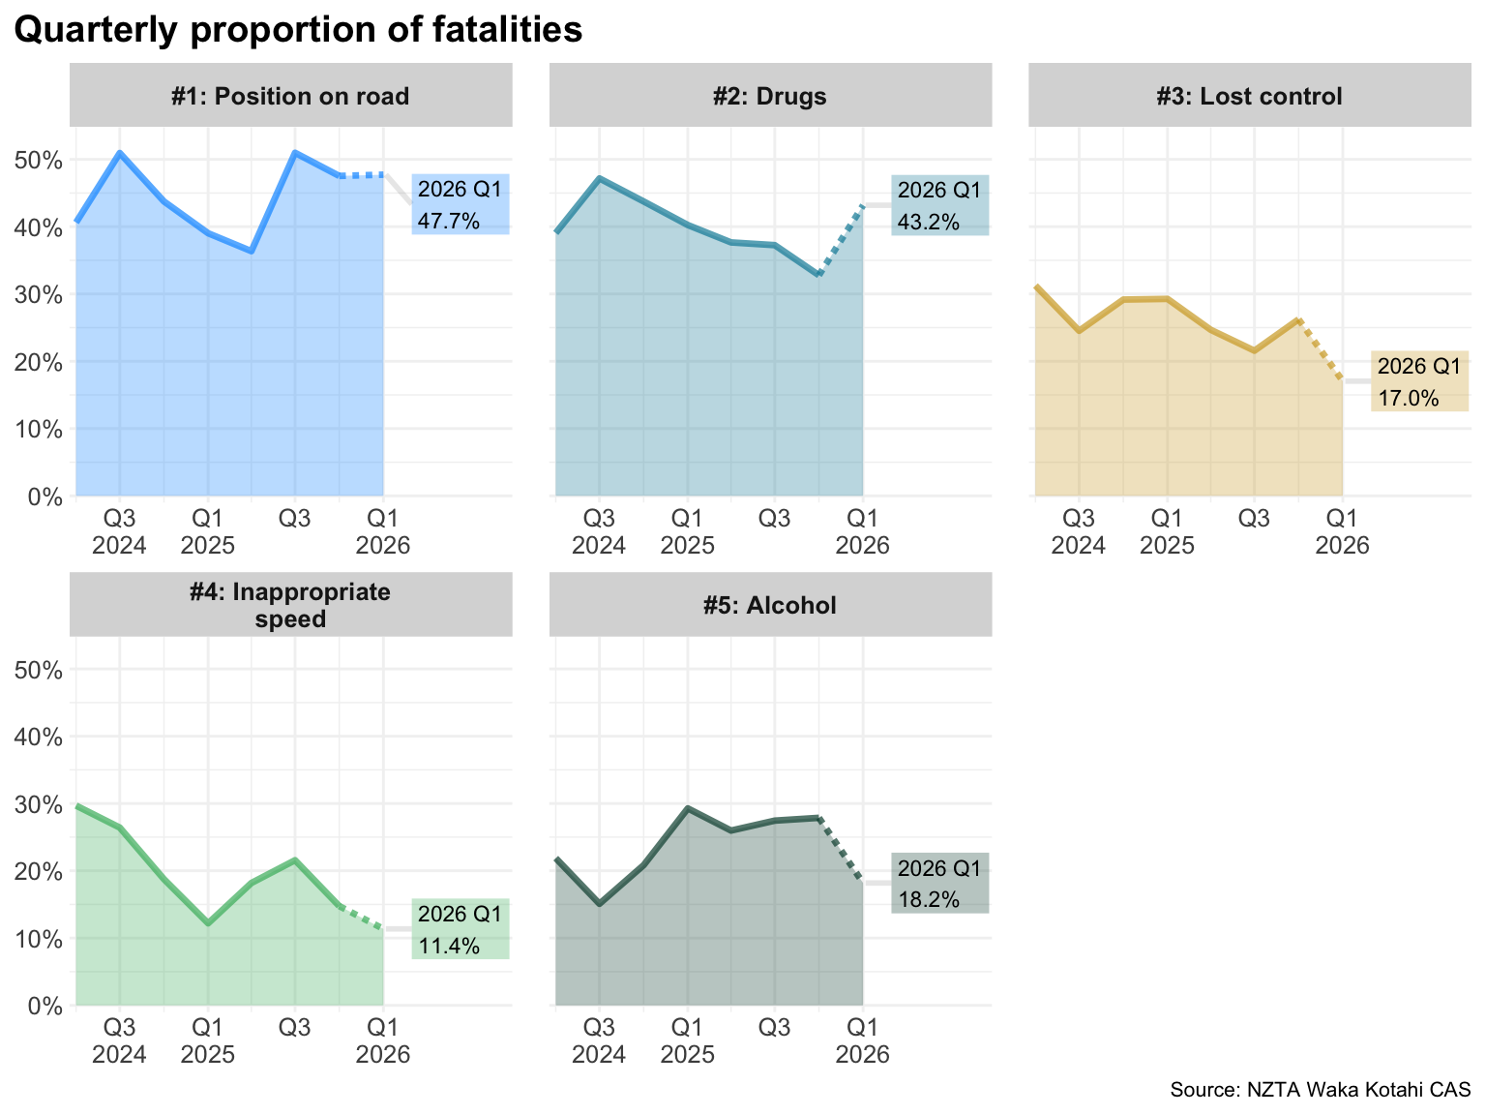
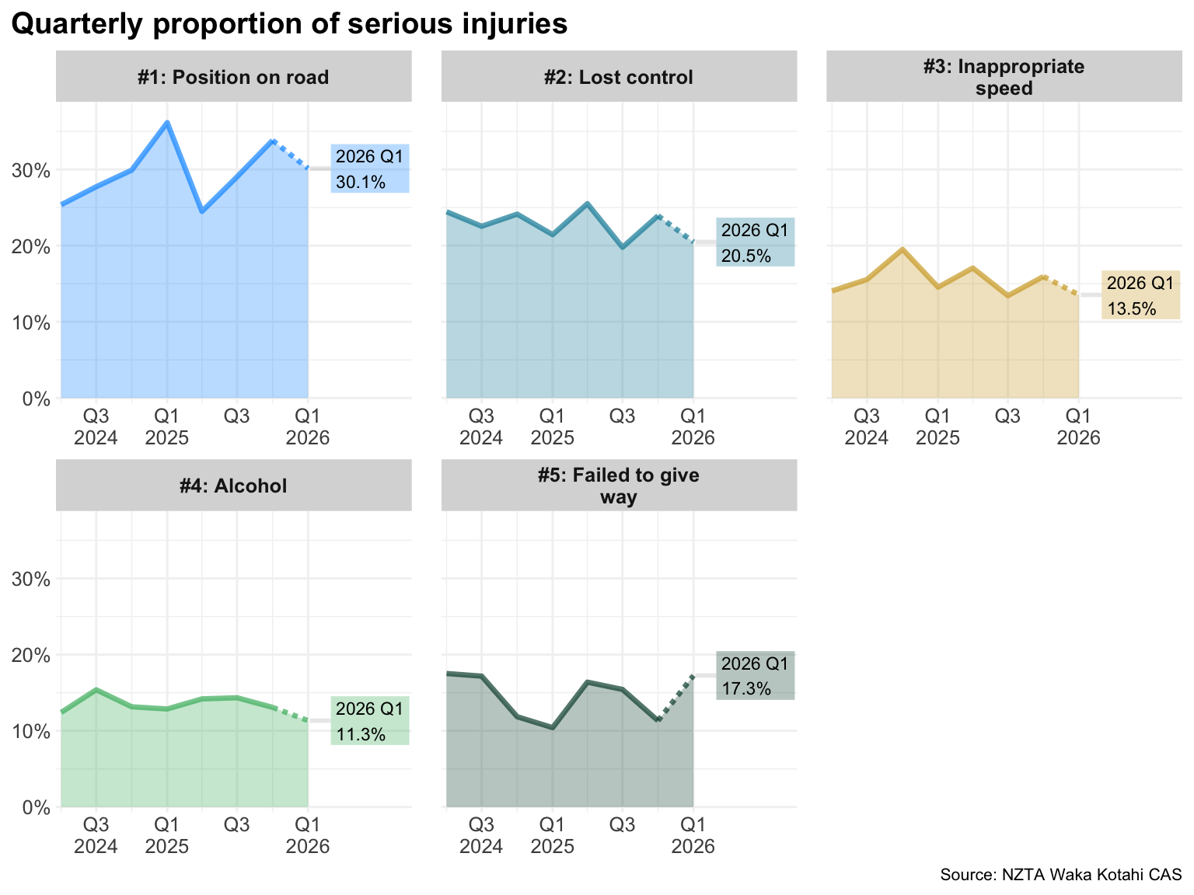
Fatal and serious injury road crashes: Top five contributing factors
Figure 3: Top five contributing factors – fatalities
Figure 4: Top five contributing factors – serious injuries
The most common contributing factors for road fatalities in the last quarter were position on road (47.7%), drugs (43.2%) and alcohol (18.2%).
The most common contributing factors for reported serious injuries in the last quarter were position on road (30.1%), losing control of the vehicle (20.5%) and failing to give way (17.3%).
Graph panels are shown in order of prevalence of contributing factors over the last two years.
NZTA has identified issues with how alcohol involvement has been coded in CAS. The data is currently under review

Slide 13
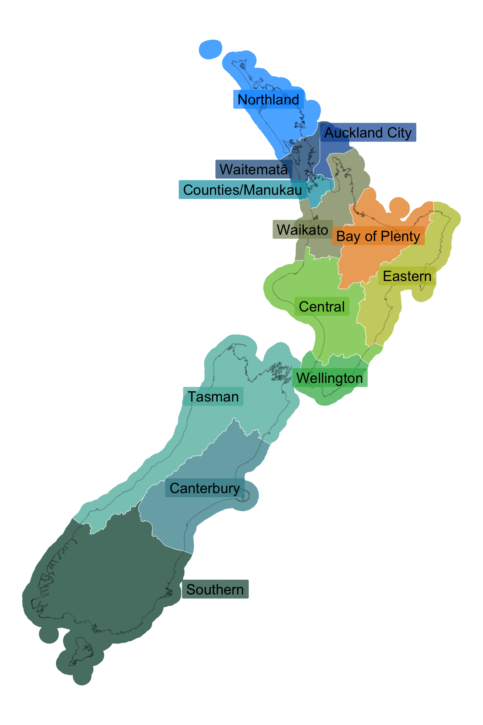
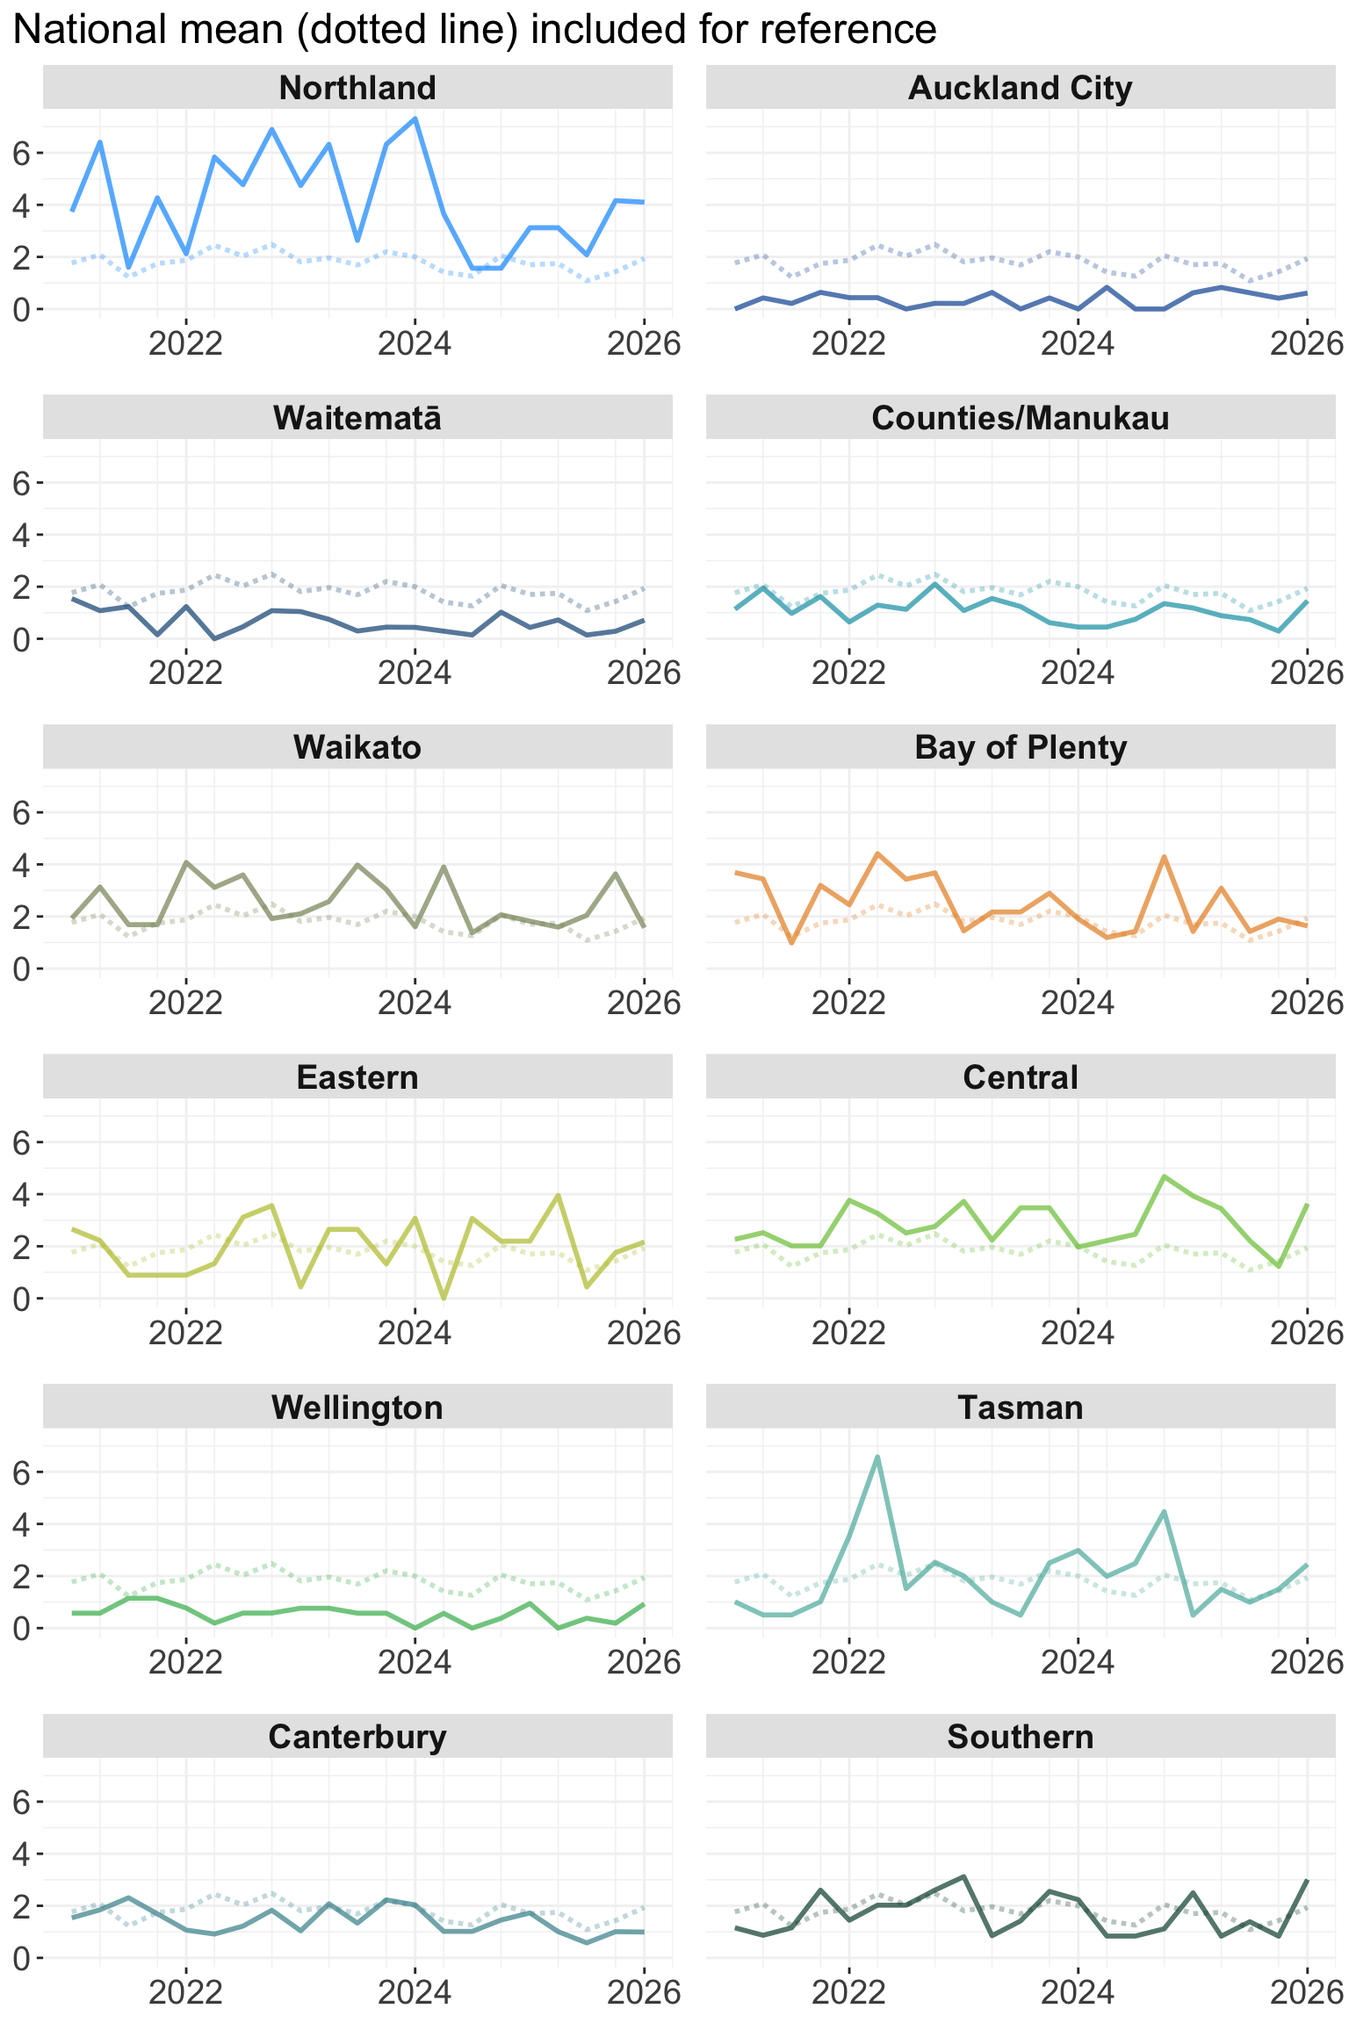
Fatalities by police district
(a) Map of police districts
Auckland City, Waitematā, Counties/Manukau, Wellington and Canterbury
police districts remain consistently below the national mean for fatalities.
Figure 5: Quarterly total fatalities by police district
(b) Fatalities per 100,000 population

Slide 14
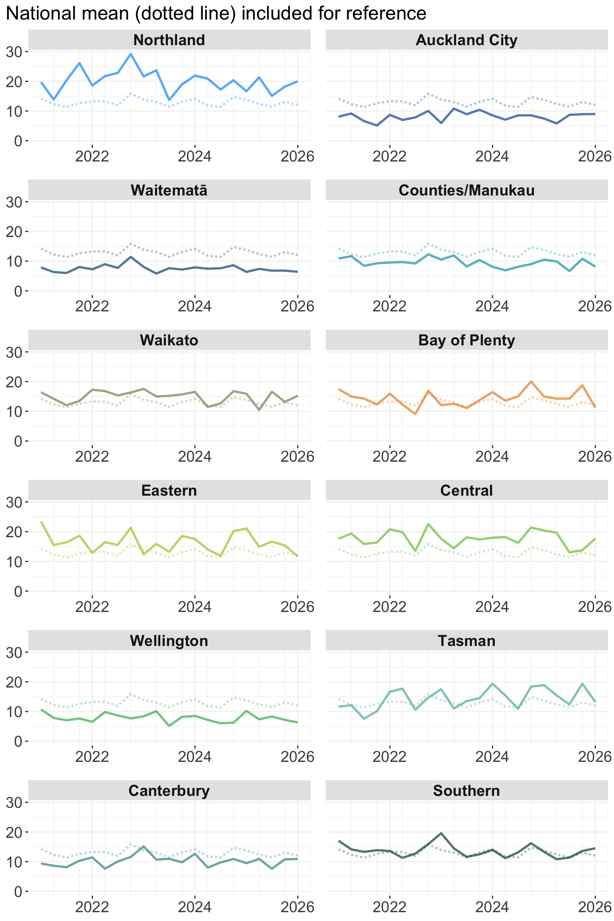
Serious injuries by police district
(a) Map of police districts
Auckland City, Waitematā, Counties/Manukau, Wellington and Canterbury police districts remain consistently below the national mean for reported serious injuries.
(b) Serious injuries reported per 100,000 population
Figure 6: Quarterly total serious injuries by police district

Slide 15
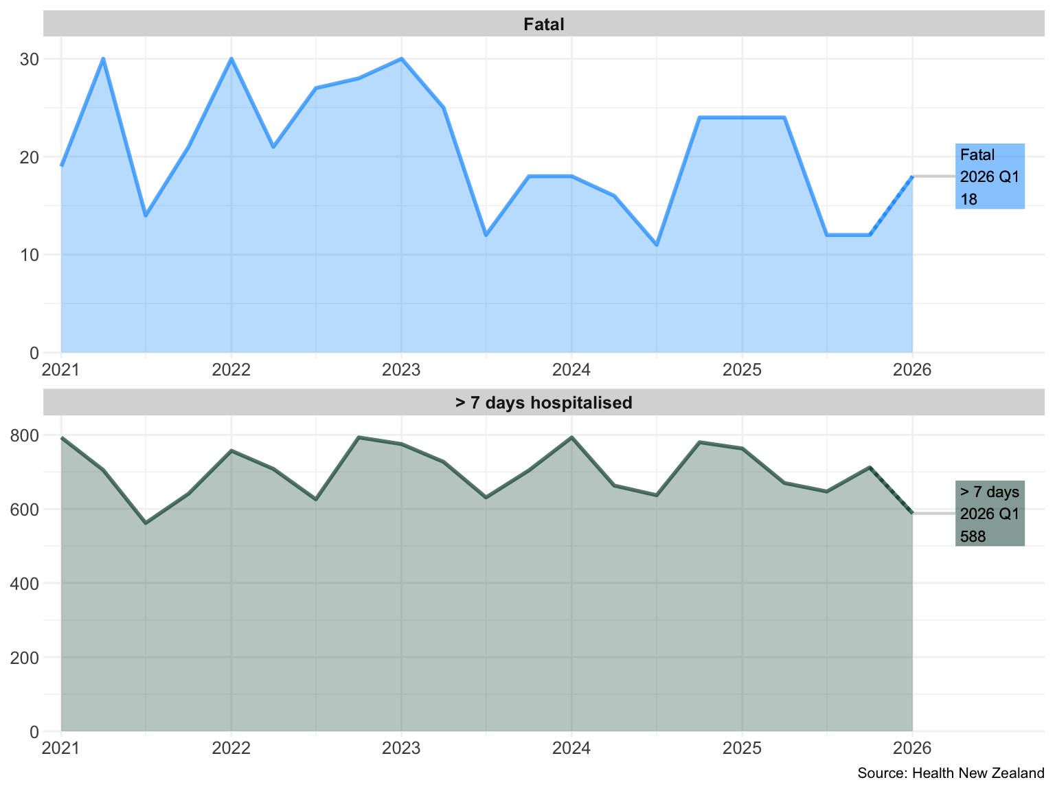
Health data: Hospitalisations
This data shows people admitted to hospital and tagged as ‘traffic accidents’.
Hospital stays for over 7 days capture more severe serious injuries. This data includes cases with or without a matched Crash Analysis System (CAS) record.
From 1 January – 31 March 2026, this data shows 18 fatalities and 588 hospitalisations for over 7 days.
Data was provided on 5 May 2026. Recent data is provisional for up to 6 months, as denoted by the dotted lines.
Figure 7: Quarterly hospitalisations from road crashes

Slide 16
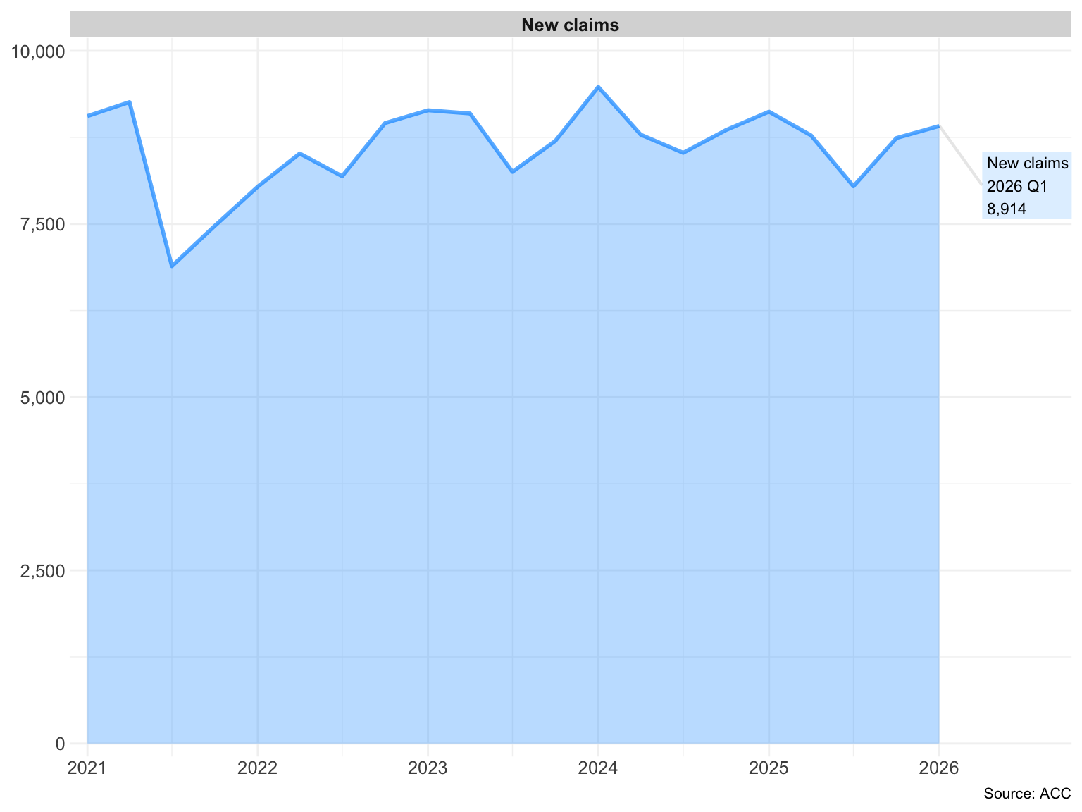
ACC data: New claims funded from the ‘Motor Vehicle’ account
This data shows new ACC claims for accidents that were funded from the motor vehicle account.
From 1 January to 31 March 2026, there were 8,914 new ACC claims for accidents that were funded from the motor vehicle account.
Figure 8: Quarterly new ACC claims funded from ‘Motor Vehicle’ account
Data was extracted on 2 July 2026.

Slide 17
This report has been compiled by the Ministry for Cities, Environment, Regions and Transport (the Ministry) with input from New Zealand Transport Agency (NZTA), New Zealand Police (Police), and the Accident Compensation Corporation (ACC). Updates on outputs are reported by lead agencies from 1 April 2026 to 30 June 2026.
Road safety data is reported from 1 January 2026 to 31 March 2026. This is due to the lag in data availability. The Crash Analysis System (CAS) contains data on crashes as reported by Police. Data from recent months is considered provisional (denoted by dotted lines), as some crash information may not be complete (eg, tests for drugs and/or alcohol have been performed but the results have not yet been entered into CAS). This is more common for serious injury crashes. CAS data for this report was extracted on 29 June 2026.

